Slide 1
Music Collection
By
Daisy Hernandez
and Julien Crespo

Slide 2
Main User Case
User will be able to create an account on the website where they are able to keep track of there created playlist and saved songs. User will be able to create personalized playlist ,giving them name and adding songs to their playlist. The user will also be able to save song directly to library as well. The website will also provide information about the song they select. By informing user about Album song belongs to, Information about the artist, release date, and duration.

Slide 3
Key point in user case:
User creates an account with username, email, and password.
Account is not a separate table because users can only have 1 account, so everything pertaining to the account just relates to the user directly.
The account has a library which can contain playlists and songs. Playlists are created by the user and contain a list of songs.
Albums are collections of songs created by artists. Every song is made by at least one artist, and songs can only be part of 1 or 0 albums.
Users can add songs to their library or add them to playlists which are in their library by default.
NOT IMPLEMENTED: users can add entire albums to their library.

Slide 4
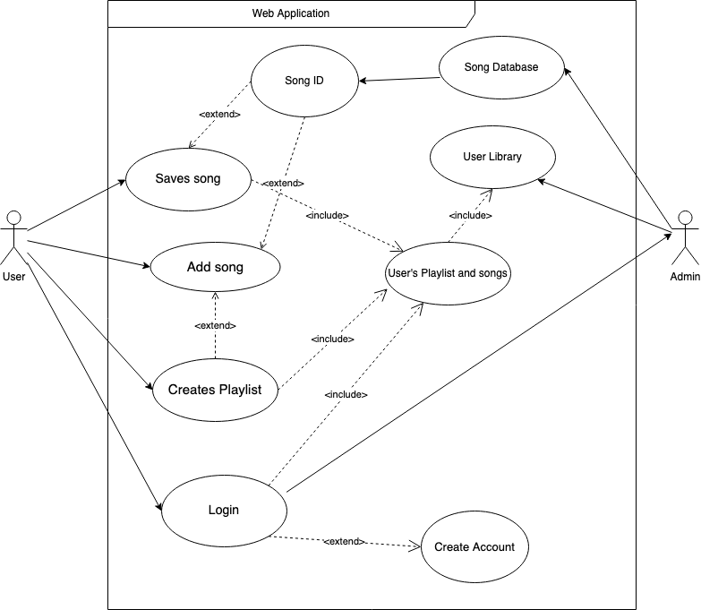
User Case Diagram

Slide 5
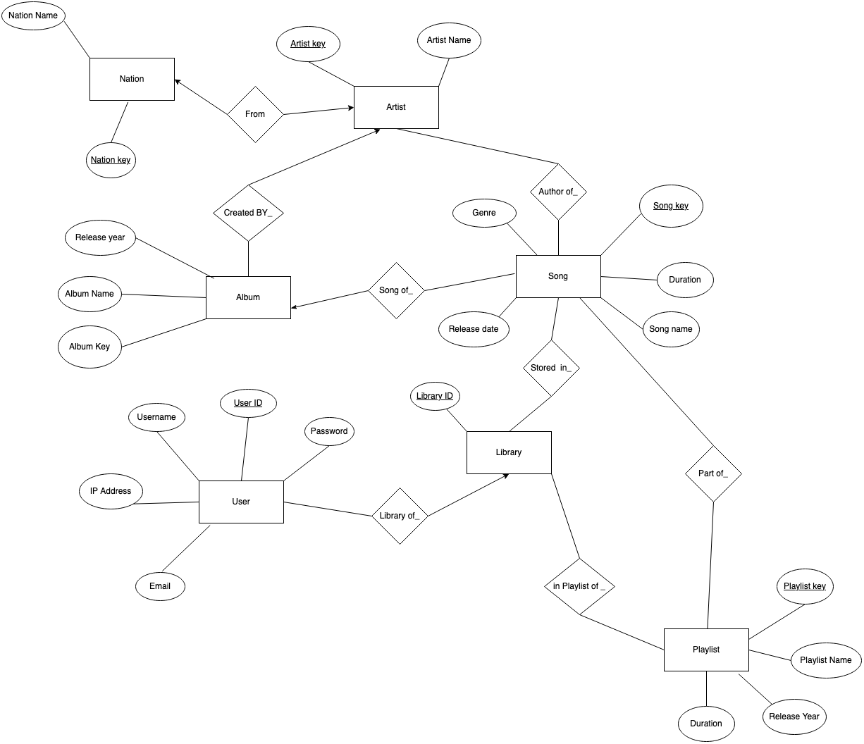
E / R Diagram

Slide 6
Relational Schema
User (User ID ,Username, Password,Email,IP address(location))
Library ( Library ID, User ID, Playlist key, Song key)
Playlist(PlayList key, PlayList Name,User ID,Song key,Duration)
Song(Song key,Song name, Duration,Genre,release date, Artist key)
Album(Album key, Album Title,Release year, Artist key, Song key)
Artist( Artist key,Nationkey, Artist Name)
Nation(Nationkey, Nation name)

